Slide 1
Software Fault Isolation
Chester Rebeiro
Indian Institute of Technology Madras

Slide 2
Web Browser Confinement
Why run C/C++ code in web browser
Javascript highly restrictive / very slow
Not suitable for high end graphics / web games
Would permit extensive client side computation
Why not to run C/C++ code in web browser
Security! Difficult to trust C/C++ code

Slide 3
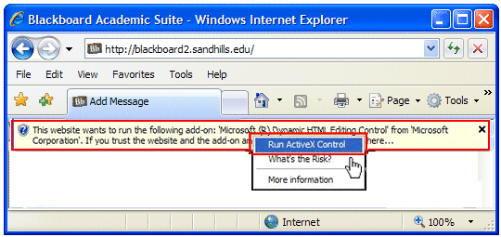
Web Browser Confinement
How to allow an untrusted module to load into a web-browser?
Trust the developer / User decides
Active X

Slide 4
Web Browser Confinement
How to allow an C/C++ in a web-browser?
Trust the developer / User decides
Active X
Fine grained confinement
(eg. NACL from Google)
Uses Software Fault Isolation

Slide 5

Fine Confinement within a Process
How to
restrict a module’s capabilities
Restrict read/modification of data in another module
(jumping outside a module and access data outside a module should be done only through prescribed interfaces)
(can use RPCs, but huge performance overheads)
Application

Slide 6
Fine Grained Confinement (Software Fault Isolation)
process space partitioned into logical domains.
Each fault domain contains data, code, and a unique ID
Code in one domain not allowed to read/modify data in another domain.
Code in one domain cannot jump to another domain.
The only way is through a low cost cross-fault-domain RPC interface not involving the OS..
Data
Code
Logical Fault Domains
(with a unique ID which is used for access control)
Operating System
Wahbe et al. Efficient Software Fault Isolation, SOSP 93
https://dl.acm.org/citation.cfm?doid=168619.168635
Notes:
Global data shared between multiple fault domains (shared data)
Calls from one fault domain to another (function calls)
System calls

Slide 7
Segments and Segment Identifier
0xabcdFFFF
MAX
Segment,
with
identifier
0xabcd
0xabcd0000
Note: A fault domain contains 2 segments (code; data+stack+heap)
Virtual address space divided into segments such that addresses in the same segment have the same upper address bits (eg in the above example the segment identifier is 0xabcd)
An untrusted module’s object is modified so that it can jump only to targets in its code segment and read/write only to addresses within its data segment.
0
process virtual
Address space

Slide 8
Segments and Segment Identifier
0xabcdFFFF
MAX
Segment,
with
identifier
0xabcd
0xabcd0000
Modify untrusted object at load time,
All legal jumps will have the same upper bits (same segment identifier)
All legal data addresses generated will also have the same upper bits (same segment identifier)
0
process virtual
Address space

Slide 9
Achieving Segmentation
Binary rewriting statically
At the time of loading, parse through the untrusted module to determine all memory read and write instructions and jump instructions.
Use unique ID (upper bits) to determine if the target address is legal
Rewriting can be done either at compile time (modifying compiler) or at load time.
A verifier is also needed when the module is loaded into the fault domain.

Slide 10
Safe & Unsafe Instructions
Safe Instructions:
Most instructions are safe (such as ALU instr)
Many of the target addresses can be resolved statically (jumps and data addresses within the same segment id. These are also safe instructions)

Slide 11
Safe Instructions
Compile time techniques / Load time techniques
Scan the binary from beginning to end.
Reliable disassembly: by scanning the executable linearly
variable length instructions may have issues
A jump may land in the middle of an instruction
Two ways to deal with this—
Ensure that all instructions are at 32 byte offsets
Ensure that all Jumps are to 32 byte offset
25 CD 80 00 00
CD 80 00 00
AND %eax, 0x000080CD
INT $0x80
AND eax, 0xffffffe0
JMP *eax

Slide 12
Unsafe Instructions
Prohibited Instructions:
Eg. int, syscall, etc.
Unsafe Instructions: Cannot be resolved statically.
For example store 0x100, [r0]
Unsafe targets need to be validated at runtime
Jumps based on registers (eg. Call *eax), and Load/stores that use indirect addressing are unsafe. Eg. JMP *eax

Slide 13
Runtime Checks for Unsafe Instructions (segment matching)
Is instruction unsafe?
Yes
Is address legal?
Yes
Trap to a system error routine outside the distrusted code
Execute Instruction
(either Jump or Memory access)

Slide 14
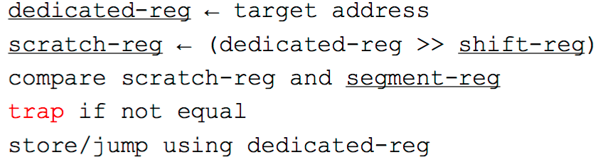
Run Time Checks Segment Matching
Insert code for every unsafe instruction that would trap if the store is made outside of the segment
4 registers required (underlined registers)
Overheads increase due to additional instructions but the increase is not as high as with RPCs across memory modules.
Notes:
Why dedicated register? – use a register which compiler doesn’t use
Can we have a jump which bypasses the checks?
SFI considers all of this as a single macro-instruction. It will not be feasible to jump in between
This can be detected at compile time itself
What happens when there is a return?
SFI is not bothered about buffer overflows.
Let the buffer overflows happen, as long as it is inside the sandbox, don’t bother
Need to make these checks before return as well.

Slide 15
Address Sandboxing
Segment matching is strong checking.
Able to detect the faulting instruction (via the trap)
Address Sandboxing : Performance can be improved if this fault detection mechanism is dropped.
Performance improved by not making the comparison but forcing the upper bits of the target address to be equal to the segment ID
Cannot catch illegal addresses but prevents module from illegally accessing outside its fault domain.
Segment Matching : Check :: Address Sandboxing : Enforce

Slide 16
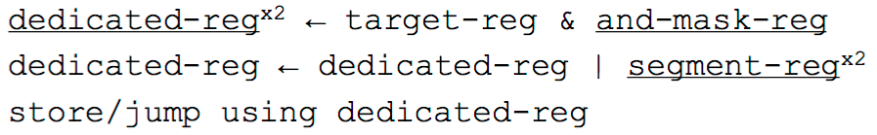
Address Sandboxing
Requires 5 dedicated registers
Enforces that the upper bits of the dedicated-reg contains the segment identifier

Slide 17
Ensure Valid Instructions
How to ensure that jump targets are at valid instruction locations
Ensure that all instructions are at 32 byte offsets
Ensure that all Jumps are to 32 byte offset
AND eax, 0xffffffe0
JMP *eax
25 CD 80 00 00
CD 80 00 00
AND %eax, 0x000080CD
INT $0x80

Slide 18
Calls between Fault Domains (light weight cross-fault-domain-RPC)
Safe calls outside a fault domain is
by jump tables.
Each entry in jump table is a control transfer instruction whose target address is a legal entry point outside the domain.
Maintained in the read only segment of the program therefore cannot be modified.
Call stub
fun()
fun
Return stub
Jump
table
Fault Domain 1
Fault Domain 2

Slide 19
Calls between Fault Domains (cross-fault-domain-RPC)
A pair of stubs for each pair of fault domains
Stubs are trusted
Present outside the fault domains
Responsible for
copying cross-domain arguments between domains
manages machine state (store/restore registers as required)
Switch execution stack
They can directly copy call arguments to the target domain
Cheap
No traps, no context switches
Call stub
fun()
fun
Return stub
Jump
table
Fault Domain 1
Fault Domain 2

Slide 20
System Resources
How to ensure that one fault domain does not alter system resources used by another fault domain
For example, does not close the file opened by another domain
One way,
Let the OS know about the fault domains
So, the OS keeps track if such violations are done at the system level
Another (more portable way),
Modify the executable so that all system calls are made through a well defined interface called cross-fault-domain-RPC.
The cross-fault-domain-RPC will make the required checks.

Slide 21

Points to Ponder
What happens if there is a buffer overflow in the isolated code?
Int buf[10];
buf[100] = 0x80402364;
Application

Slide 22
Shared Data (Global / Heap Variables)
Page tables in kernel modified so that shared memory mapped to every segment that needs access to it
MAX
process tables
Shared page
0
process virtual
Address space
Physical address space

Slide 23
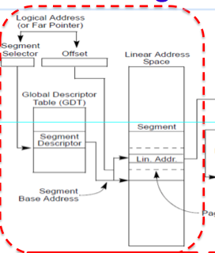
Segmentation (Hardware Support for Sandboxing)

Slide 24
Segmentation Example
0x3000 (descriptor table)
0x3000
Segment | Base | Limit
0 | - | -
1 | 1000 | 1000
2 | 4000 | 500
3 | 8000 | 1000
4 | 9000 | 1000
pointer to descriptor table
(logical address)
1
+
1100
segment register (eg %CS)
(linear address)
100
offset register (eg %eip)

Slide 25
Segmentation In Sandboxing
Create segments for each sandbox
Make segment registers (CS, ES, DS, SS) point to these segments
Need to ensure that the untrusted code does not modify the segment registers
Jumping out of a segment: need to change segment registers appropriately

